Slide 1
ALGORITHM ANALYSIS
AND DESIGN
LAB
(ETCS-351)

Slide 2
Software to be used
Turbo c, c++
Linux ,
code blocks or
any online c compiler

Slide 3
List of Experiments
To implement following algorithm using array as a data structure and analyse its time complexity.
Merge sort
Quick sort
Bubble sort
Bucket sort
Radix sort
Shell sort
Selection sort
Heap sort
To implement Linear search and Binary search and analyse its time complexity.
To implement Matrix Multiplication and analyse its time complexity.
To implement Longest Common Subsequence problem and analyse its time complexity.
To implement Optimal Binary Search Tree problem and analyse its time complexity.
To implement Huffman Coding and analyse its time complexity.
To implement Dijkstra’s algorithm and analyse its time complexity.
To implement Bellman Ford algorithm and analyse its time complexity.
To implement naïve String Matching algorithm, Rabin Karp algorithm and Knuth Morris Pratt algorithm and analyse its time complexity.

Slide 4
The programs to be done in the lab are divided in different sections.
The programs listed in first section will be done in 2 labs. The programs in this section are sorting algorithms

Slide 5
LAB 1 AND 2

Slide 6
SORTING ALGORITHMS
To implement following algorithm using array as a data structure and analyze their time complexity.
Insertion sort
Selection sort
Bubble sort
Radix sort
Shell sort
Heap sort
Bucket sort

Slide 7
STEPS TO BE TAKEN IMPLEMENT PROGRAMMS IN sorting algorithms implementation
The programs listed in first section will be done in 2 labs.
The first section is about complexities of various sorting algorithms.
Best, Average and Worst case complexities of various sorting techniques is compared by plotting graph for varying input sizes and time required by the particular algorithm.
The best case complexity of the algorithm is the function defined by the minimum number of steps taken on any instance of size n.
The worst case complexity of the algorithm is the function defined by the maximum number of steps taken on any instance of size n.
The average-case complexity of the algorithm is the function defined by an average number of steps taken on any instance of size n. Each of these complexities defines a numerical function - time vs. size.

Slide 8
How Graph Has To Be Plotted For Sorting Algorithms
Input size has to be plotted along X-axis.
Time taken has to be plotted along Y-axis.
The curve to be plotted by free hand.
Output for different output sizes has to be stored in tables.
Tables for all the cases that is worst, average and best case has to be made.

Slide 9
INSERTION SORT
Insertion sort is a simple sorting algorithm that is relatively efficient for small lists and mostly-sorted lists, and often is used as part of more sophisticated algorithms. It works by taking elements from the list one by one and inserting them in their correct position into new sorted list. In arrays, the new list and the remaining elements can share the array's space, but insertion is expensive, requiring shifting all following elements over by one. The insertion sort works just like its name suggests - it inserts each item into its proper place in the final list. The simplest implementation of this requires two list structures - the source list and the list into which sorted items are inserted. To save memory, most implementations use an in-place sort that works by moving the current item past the already sorted items and repeatedly swapping it with the preceding item until it is in place. Shell sort a variant of insertion sort that is more efficient for larger lists.

Slide 10
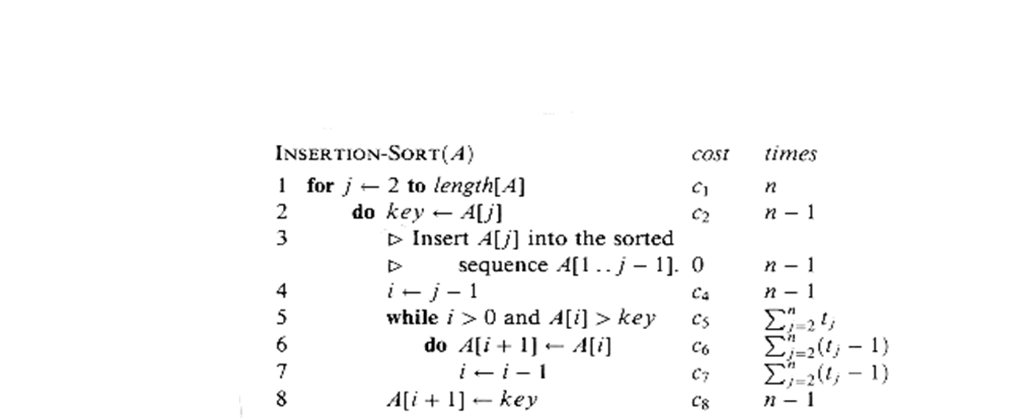

Slide 11
Selection sort
The selection sort algorithm sorts an array by repeatedly finding the minimum element (considering ascending order) from unsorted part and putting it at the beginning. The algorithm maintains two subarrays in a given array.
1) The subarray which is already sorted.
2) Remaining subarray which is unsorted.
In every iteration of selection sort, the minimum element (considering ascending order) from the unsorted subarray is picked and moved to the sorted subarray.

Slide 12
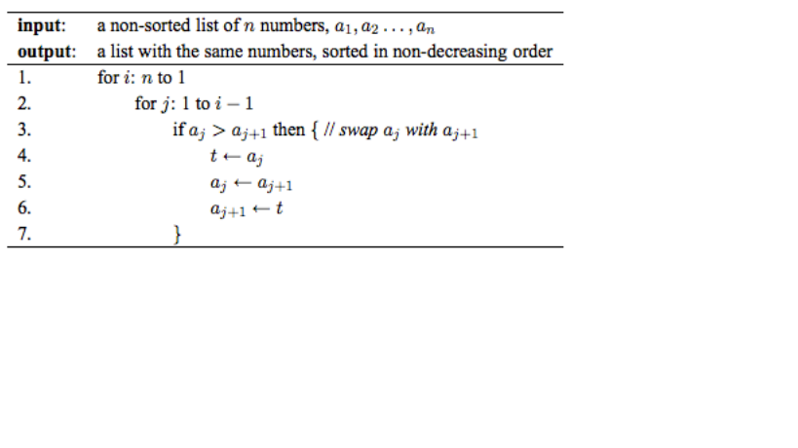
Bubble sort pseudocode

Slide 13
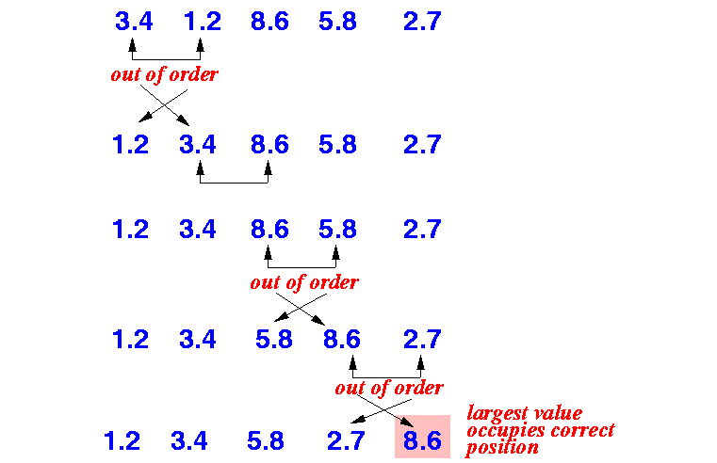
Bubble sort Example

Slide 14
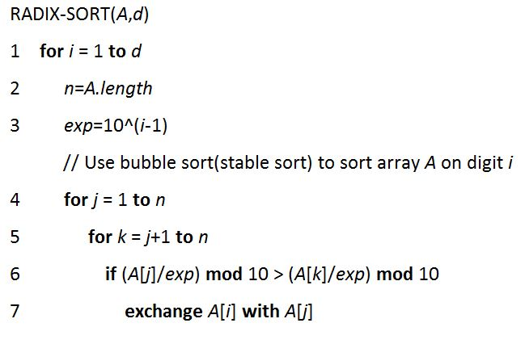
Radix sort pseudocode

Slide 15
Shell sort
The shell sorting technique is based on the insertion sort. In the insertion sort sometimes we need to shift large block to insert an item in the correct location. Using shell sort, we can avoid a large number of shifting. The sorting is done with a specific interval. After each pass, the interval is reduced to make the smaller interval.
The complexity of the Shell Sort Technique
Time Complexity: O(n log n) for best case, and for other cases, it depends on the gap sequence.
Space Complexity: O(1)

Slide 16
Heap sort
Heapsort(A)
{ BuildHeap(A)
for i <- length(A) downto 2
{ exchange A[1] <-> A[i]
heapsize <- heapsize -1
Heapify(A, 1)
}
BuildHeap(A)
{ heapsize <- length(A)
for i <- floor( length/2 ) downto 1
Heapify(A, i)
}
Heapify(A, i)
{
le <- left(i)
ri <- right(i)
if (le<=heapsize) and (A[le]>A[i])
largest <- le
else
largest <- i
if (ri<=heapsize) and (A[ri]>A[largest])
largest <- r
i if (largest != i)
exchange A[i] <-> A[largest] Heapify(A, largest)
}
}

Slide 17
Bucket sort
In the Bucket Sorting technique, the data items are distributed in a set of buckets. Each bucket can hold a similar type of data. After distributing, each bucket is sorted using another sorting algorithm. After that, all elements are gathered on the main list to get the sorted form.
The complexity of the Bucket Sort Technique
Time Complexity: O(n + k) for best case and average case and O(n^2) for the worst case.
Space Complexity: O(nk) for worst case

Slide 18
After first two labs students should be able to answer the following questions:
Define Omega notation.
Define Big-O notation.
Define Theta notation.
What is an algorithm?
What is a randomized algorithm?
What are loop invariants? How it is shown that an algorithm is correct?
What is a Pseudocode?
What are the worst case and average case running time of insertion sort?

Slide 19
LAB 3

Slide 20
The programs listed in second section are based on searching and comparing their complexities

Slide 21
LINEAR SEARCH
Linear Search is the simplest searching algorithm.
It traverses the array sequentially to locate the required element.
It searches for an element by comparing it with each element of the array one by one.
So, it is also called as Sequential Search.
Linear Search Algorithm is applied when-
No information is given about the array.
The given array is unsorted or the elements are unordered.
The list of data items is smaller.

Slide 22
LINEAR SEARCH PSEUDOCODE
Linear_Search (a , n , item , loc)
Begin
for i = 0 to (n - 1) by 1 do
if (a[i] = item) then
set loc = i
Exit
endif
endfor
set loc = -1
End

Slide 23
FOR IMPLEMENTING LINEAR SEARCH
Input the size of array
Input an array
Input the item to be searched and take print out for both
item exists in array and
it does not exist.

Slide 24
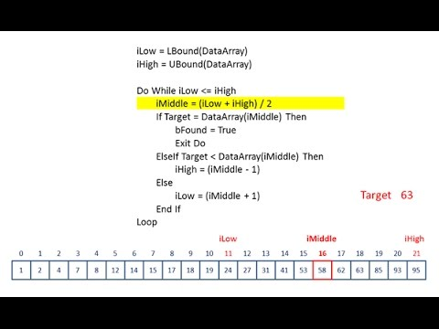
BINARY SEARCH

Slide 25
FOR IMPLEMENTING BINARY SEARCH
Input the size of array
Input a sorted array
Input the item to be searched and take print out for both
item exists in array and
it does not exist.

Slide 26
BINARY SEARCH COMPLEXITY
Best-case performance | O(1)
Average performance | O(log n)
Worst-case space complexity | O(1)

Slide 27
LAB 4

Slide 28
The third section is about divide and conquer technique. To use divide and conquer as an algorithm design technique, the problem must be divided into two smaller subproblems, solve each of them recursively, and then meld the two partial solutions into one solution to the full problem. Whenever the merging takes less time than solving the two subproblems, we get an efficient algorithm. Mergesort is the classic example of a divide-and-conquer algorithm. It takes only linear time to merge two sorted lists of n/2 elements each of which was obtained in
time. Divide and conquer is a design technique with many important algorithms to its credit, including mergesort, the fast Fourier transform, and Strassen's matrix multiplication algorithm.

Slide 29
MERGE SORT
Merge sort takes advantage of the ease of merging already sorted lists into a new sorted list. It starts by comparing every two elements (i.e. 1 with 2, then 3 with 4...) and swapping them if the first should come after the second. It then merges each of the resulting lists of two into lists of four, then merges those lists of four, and so on; until at last two lists are merged into the final sorted list. Of the algorithms described here, this is the first that scales well to very large lists.
Merge sort works as follows:
1. Divide the unsorted list into two sub lists of about half the size
2. Sort each of the two sub lists
3. Merge the two sorted sub lists back into one sorted list.

Slide 30
MERGE SORT pseudocode
mergesort(m)
var list left, right
if length(m) ≤ 1
return m
else
middle = length(m) / 2
for each x in m up to middle
add x to left
for each x in m after middle
add x to right
left = mergesort(left)
right = mergesort(right)
result = merge(left, right)
return result

Slide 31
MERGE SORT pseudocode
merge(left,right)
var list result
while length(left) > 0 and length(right) > 0
if first(left) ≤ first(right)
append first(left) to result
left = rest(left)
else
append first(right) to result
right = rest(right)
if length(left) > 0
append left to result
if length(right) > 0
append right to result
return result

Slide 32
QUICK SORT
Quicksort is a divide and conquer algorithm which relies on a partition operation: to partition an array, an element, called a pivot is chosen, all smaller elements are moved before the pivot, and all greater elements are moved after it. This can be done efficiently in linear time and in-place. Then recursively sorting can be done for the lesser and greater sub lists. Efficient implementations of quicksort (with in-place partitioning) are typically unstable sorts and somewhat complex, but are among the fastest sorting algorithms in practice. Together with its modest O(log n) space usage, this makes quicksort one of the most popular sorting algorithms, available in many standard libraries. The most complex issue in quicksort is choosing a good pivot element; consistently poor choices of pivots can result in drastically slower (O(n²)) performance, but if at each step we choose the median as the pivot then it works in O(n log n).
Quicksort sorts by employing a divide and conquer strategy to divide a list into two sub-lists.
Pick an element, called a pivot, from the list.
Reorder the list so that all elements which are less than pivot come before the pivot and so that all elements greater than the pivot come after it (equal values can go either way). After this partitioning, the pivot is in its final position. This is called the partition operation.
Recursively sort the sub-list of lesser elements and the sub-list of greater elements.

Slide 33
QUICK SORT PSEUDOCODE
Pseudocode For partition(a, left, right, pivotIndex)
pivotValue := a[pivotIndex]
swap(a[pivotIndex], a[right]) // Move pivot to end
storeIndex := left
for i from left to right-1
if a[i] ≤ pivotValue
swap(a[storeIndex], a[i])
storeIndex := storeIndex + 1
swap(a[right], a[storeIndex]) // Move pivot to its final place
return storeIndex

Slide 34
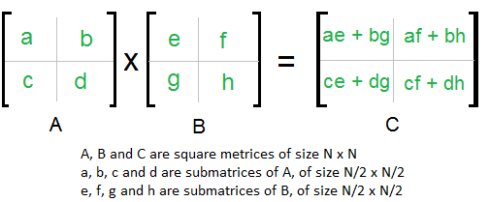
STRASSEN’S ALGORITHM FOR MATRIX MULTIPLICATION
Divide and Conquer Following is simple Divide and Conquer method to multiply two square matrices. 1) Divide matrices A and B in 4 sub-matrices of size N/2 x N/2 as shown in the below diagram. 2) Calculate following values recursively. ae + bg, af + bh, ce + dg and cf + dh.

Slide 35
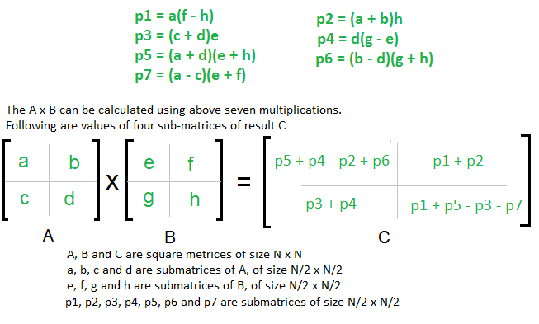
STRASSEN’S ALGORITHM FOR MATRIX MULTIPLICATION

Slide 36
FOR IMPLEMENTING starrsen’s algorithm
Enter two 2*2 matrices.
Calculate all p1,p2,p3,p4,p5,p6,p7.
Find the multiplication matrix using Strassen’s equations and output should be displayed in matrix form.

Slide 37
After this lab students should be able to answer the following questions:
Which technique is used to sort elements in merge sort?
What is the running time of merge sort?
How merge sort is different from quick sort?
Name different methods to solve recurrences.
What is the worst case running time of quick sort?
Define i-th order statistics of a set.
What is median of a set?

Slide 38
LAB 5 and 6

Slide 39
This section is about dynamic programming technique. Dynamic programming solves problems by combining the solution of sub problems. It is only applicable when sub problems are not independent, that is, they share sub sub- Problems. Each time a new sub problem is solved, its solution is stored such that other sub problems sharing the stored sub problem can use the stored value instead of doing a recalculation, thereby saving work compared to applying the divide- and-conquer principle on the same problem which would have recalculated everything.

Slide 40
A dynamic programming solution has three components: Formulate the answer as a recurrence relation or recursive algorithm. Show that the number of different instances of your recurrence is bounded by a polynomial. Specify an order of evaluation for the recurrence so you always have what you need.

Slide 41
DYNAMIC PROGRAMMING:
To Implement Matrix Chain Multiplication.
To Implement Largest Common Subsequence.
To Implement Optimal Binary Search Tree.
To Implement Binomial coefficient computation.

Slide 42
Pseudocode MatrixOrder for i=1 to n do M[i, j]=0 for diagonal=1 to n-1 for i=1 to n-diagonal do j=i+diagonal faster(i,j)=k return [m(1, n)]

Slide 43
Pseudocode MatrixOrder for i=1 to n do M[i, j]=0 for diagonal=1 to n-1 for i=1 to n-diagonal do j=i+diagonal faster(i,j)=k return [m(1, n)]

Slide 44
FOR IMPLEMENTING MATRIX CHAIN MULTIPLICATION
Enter a chain of matricies along with their dimensions.
Find the optimal solution.
Print the table for M and k-values.
Print the optimal parenthesization for matrices.

Slide 45

LONGEST COMMON SUBSEQUENCE PROBLEM
The longest common subsequence problem (LCS) is finding a longest sequence which is a
subsequence of all sequences in a set of sequences (often just two). The problem is sometimes
defined to be finding all longest common subsequences.
It should not be confused with the longest common substring problem (a substring is necessarily
a contiguous part).
Here + denotes concatenation, and max' gives the longest sequence.
Since this problem has an optimal substructure property, it can be solved by dynamic programming.
The rationale for this recurrence is that, if the last character of two sequences are equal, they must be part of the LCS. A larger LCS can never be obtained by matching x_{m} to y_{j} where j < n, and vice versa. To find all the longest common subsequences, the LCS should be denoted as a set of sequences, and 'max should return both solutions if they are equally long.

Slide 46
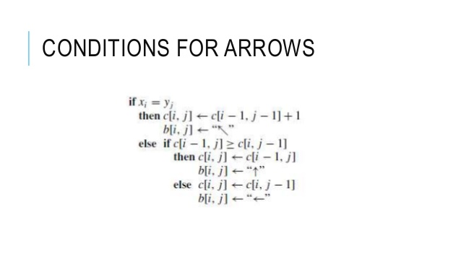
Longest common subsequence

Slide 47
FOR IMPLEMENTING LONGEST COMMON SUBSEQUENCE
Enter two sequences of alphabets or binary numbers.
Using the algorithm print table for c(Xi,Yj),b(for arrows).
Print longest common subsequence also.

Slide 48
OPTIMAL BINARY SEARCH TREE
Optimal-Binary-Search-Tree(p, q, n)
e[1…n + 1, 0…n],
w[1…n + 1, 0…n],
root[1…n + 1, 0…n]
for i = 1 to n + 1 do
e[i, i - 1] := q_{i} - 1
w[i, i - 1] := q_{i} - 1
for l = 1 to n do
for i = 1 to n – l + 1
do j = i + l – 1
e[i, j] := ∞
w[i, i] := w[i, i -1] + p_{j} + q_{j}
for r = i to j do
t := e[i, r - 1] + e[r + 1, j] + w[i, j]
if t < e[i, j] e[i, j] := t
root[i, j] := r
return e and root

Slide 49
FOR IMPLEMENTING OBST
Enter keys with probabilities of finding keys.
Enter the probabilities of dummy keys.
Print the tables for w,e,r.
Print root of tree.

Slide 50
LAB 7

Slide 51
GREEDY ALGORITHM’S
To implement Knapsack Problem.
To implement Activity Selection Problem.
To implement Huffman Coding and analyze its time complexity.
To implement Task Scheduling Problem.

Slide 52
This section is about Greedy strategy of designing algorithms. The experiments will be done in two labs. In greedy strategy algorithm always takes the best immediate, or local, solution while finding an answer. Greedy algorithms find the overall, or globally, optimal solution for some optimization problems, but may find less-than-optimal solutions for some instances of other problems.

Slide 53
GREEDY ALGORITHMS
To construct the solution in an optimal way, Algorithm maintains two sets. One contains chosen items and the other contains rejected items.
The greedy algorithm consists of four function.
A function that checks whether chosen set of items provide a solution.
A function that checks the feasibility of a set.
The selection function tells which of the candidates is the most promising.
An objective function, which does not appear explicitly, gives the value of a solution.
Structure Greedy Algorithm
Initially the set of chosen items is empty i.e., solution set.
At each step
item will be added in a solution set by using selection function.
IF the set would no longer be feasible
reject items under consideration (and is never consider again).
ELSE IF set is still feasible THEN
add the current item.

Slide 54
KNAPSACK PROBLEM
The knapsack problem is a problem in combinatorial optimization. It derives its name from the maximization problem of choosing possible essentials that can fit into one bag (of maximum weight) to be carried on a trip. A similar problem very often appears in business, combinatorics, complexity theory, cryptography and applied mathematics. Given a set of items, each with a cost and a value, then determine the number of each item to include in a collection so that the total cost is less than some given cost and the total value is as large as possible.
Greedy approximation algorithm
Martello and Toth (1990) proposed a greedy approximation algorithm to solve the knapsack problem. Their version sorts the essentials in decreasing order and then proceeds to insert them into the sack, starting from the first element (the greatest) until there is no longer space in the sack for more. If k is the maximum possible number of essentials that can fit into the sack, the greedy algorithm is guaranteed to insert at least k/2 of them.

Slide 55
FOR IMPLEMENTING fractional knapsack
Enter the maximum capacity of the bag.
Enter the number of items.
Enter the weight(wi) and cost(pi) of each item in descending order of pi/wi ratio.
Print fraction of each item that can be filled in the bag so as to maximize the value.

Slide 56
AN ACTIVITY SELECTION PROBLEM
Problem Statement
Given a set S of n activities with and start time, S_{i} and f_{i}, finish time of an i^{th} activity. Find the maximum size set of mutually compatible activities.
Compatible Activities
Activities i and j are compatible if the half-open internal [s_{i}, f_{i}) and [s_{j}, f_{j}) do not overlap, that is, i and j are compatible if s_{i} ≥ f_{j} and s_{j} ≥ f_{i}
I. Sort the input activities by increasing finishing time. f₁ ≤ f₂ ≤ . . . ≤ f_{n}

Slide 57
Greedy Algorithm for Selection Problem
I. Sort the input activities by increasing finishing time. f₁ ≤ f₂ ≤ . . . ≤ f_{n}
II. Call GREEDY-ACTIVITY-SELECTOR (s, f)
n = length [s]
A={i}
j = 1
for i = 2 to n
do if s_{i} ≥ f_{j}
then A= AU{i}
j = i
return set A

Slide 58
FOR IMPLEMENTING activity selection
Enter number of activities.
Enter the finishing time of activities in ascending order.
Enter the starting time of activities.
Print the set of compatible activities that can be performed.

Slide 59
After this lab students should be able to answer the following questions:
What are the differences between dynamic and greedy algorithms?
What are Huffman codes?
What are fixed length and variable length codes?

Slide 60
LAB 8

Slide 61
This lab is related to graphs. A graph is a kind of data structure , that consists of a set of nodes and a set of edges that establish relationships (connections) between the nodes.

Slide 62
SHORTEST PATH GRAPH ALGORITHMS
To implement Dijkstra’s Algorithm.
To implement Floyd Warshall’s Algorithm.
To implement Bellman Ford’s Algorithm

Slide 63
DIJKSTRA'S ALGORITHM
Dijkstra's algorithm solves the single-source shortest-path problem when all edges have non-negative weights. It is a greedy algorithm and similar to Prim's algorithm. Algorithm starts at the source vertex, s, it grows a tree, T, that ultimately spans all vertices reachable from S. Vertices are added to T in order of distance i.e., first S, then the vertex closest to S, then the next closest, and so on. Following implementation assumes that graph G is represented by adjacency lists.

Slide 64
DIJKSTRA (G, w, s)
INITIALIZE SINGLE-SOURCE (G, s)
S ← { } // S will ultimately contains vertices of final shortest-path weights from s
Initialize priority queue Q i.e., Q ← V[G]
while priority queue Q is not empty do
u ← EXTRACT_MIN(Q) // Pull out new vertex
S ← S È {u} // Perform relaxation for each vertex v adjacent to u
for each vertex v in Adj[u] do
Relax (u, v, w)
ANALYSIS
Like Prim's algorithm, Dijkstra's algorithm runs in O(|E|lg|V|) time.

Slide 65
FOR IMPLEMENTING Dijakstra shortest path algorithm
Enter a graph using adjacency list.
Enter the cost of each edge.
Enter the source vertex
Find shortest distances for all vertices reachable from source.

Slide 66
FLOYD Warshall’s algorithm
Steps to implement Floyd Warshall’s algorithm
[Initialize matrix m]
Repeat through step 2 fir I = 0 ,1 ,2 ,3 ,….., n – 1
Repeat through step 2 fir j =0 ,1 ,2 ,3 ,….., n – 1
[Test the condition and assign the required value to matrix m]
If a [ I ] [j] = 0
M [ I ] [ j ] = infinity
Else
M [ I ] [ j ] = a [ I ] [ j ]
3. [ Shortest path evaluation ]
Repeat through step 4 for k = 0 , 1 , 2 , 3 , …. , n – 1
Repeat through step 4 for I = 0 , 1 , 2 , 3 , …. , n – 1
Repeat through step 4 for j = 0 , 1 , 2 , 3 , …. , n – 1
4 . If m [ I ] [j] < m [ I ][k] + m[k][j]
M[i][ j] = m [ I ] [ j ]
Else
M [I ] [ j ] = m [ I ] [ j ] +m [ k] [ j ]
5 . Exit
ANALYSIS
The time complexity is Θ (V³).

Slide 67
FOR IMPLEMENTING Floyd warshall shortest path algorithm
Enter the graph using adjacency matrix(cost matrix).
Display the final shortest path cost matrix.

Slide 68
BELLMAN-FORD ALGORITHM
INITIALIZE-SINGLE-SOURCE (G, s)
for each vertex i = 1 to V[G] - 1 do
for each edge (u, v) in E[G] do
RELAX (u, v, w)
For each edge (u, v) in E[G] do
if d[u] + w(u, v) < d[v] then
return FALSE
return TRUE

Slide 69
FOR IMPLEMENTING bellman ford shortest path algorithm
Enter a graph using adjacency list.
Enter the cost of each edge.
Enter the source vertex.
Find shortest distances for all vertices reachable from source.
Print the output in two cases
Bellman ford algorithm can find shortest path.
It returns false i.e. existence of negative weight cycle.

Slide 70
After this lab students should be able to answer the following questions:
How graphs are represented in computer memory?
Compare an adjacency list and adjacency matrix
What is a negative weight cycle?
Dijkstra algorithm can take into account the negative edge weigthts.'Is the statement true?

Slide 71
LAB 9

Slide 72
This section is about spanning tree. One application of spanning tree could be a cable TV company laying cable to a new neighborhood. If it is constrained to bury the cable only along certain paths, then there would be a graph representing which points are connected by those paths.

Slide 73
MINIMUM SPANNING TREE ALGORITHMS
To implement Kruskal’s Algorithm.
To implement Prim’s Algorithm.

Slide 74
Prim’s algorithm
Minimum-Spanning-Tree-by-Prim(G, weight-function, source)
for each vertex u in graph G
set key of u to ∞
set parent of u to nil
set key of source vertex to zero
enqueue to minimum-heap Q all vertices in graph G.
while Q is not empty
extract vertex u from Q // u is the vertex with the lowest key that is in Q
for each adjacent vertex v of u do
if (v is still in Q) and (weight-function(u, v) < key of v) then
set u to be parent of v // in minimum-spanning-tree11
update v's key to equal weight-function(u, v)

Slide 75
KRUSKAL'S ALGORITHM
function Kruskal(G)
for each vertex v in G do
Define an elementary cluster C(v) ← {v}.
Initialize a priority queue Q to contain all edges in G, using the weights as keys.
Define a tree T ← Ø //T will ultimately contain the edges of the MST
while T has fewer than n-1 edges do
(u,v) ← Q.removeMin()
Let C(v) be the cluster containing v, and let C(u) be the cluster containing u.
if C(v) ≠ C(u) then
Add edge (v,u) to T.
Merge C(v) and C(u) into one cluster, that is, union C(v) and C(u).
return tree T
function Kruskal(G) 2 for each vertex v in G do 3 Define an elementary cluster C(v) ← {v}. 4

Slide 76
FOR IMPLEMENTING Minimum spanning tree
Enter the graph in form of adjacency list.
Enter the cost of each edge.
Find the minimum spanning tree edges and minimum cost.

Slide 77
After this lab students should be able to answer the following questions:
Define minimum spanning tree.’
Name any algorithm for finding the minimum spanning tree.
Compare Prim's and Kruskal's algorithm.

Slide 78
LAB 10

Slide 79
This section is about string matching algorithms .The problem of string matching is a prevalent and important problem in computer science today. The problem is to search for a pattern string, pat[1..m], in a text string txt[1..n].
Usually n>>m, and txt might be very long indeed, although this is not necessarily so.

Slide 80
STRING MATCHING ALGORITHMS
To implement Naïve String Matching Algorithm.
To implement Rabin Karp String Matching Algorithm
To implement Knuth Morris Pratt algorithm

Slide 81
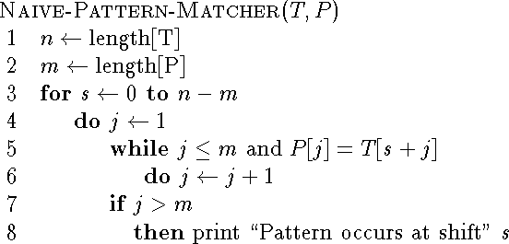
NAIVE STRING MATCHING
The naive string searching algorithm is to examine each position, i>=1, in txt, trying for equality of pat[1..m] with txt[i..i+m-1]. If there is inequality, position i+1 is tried, and so on.
Algorithm

Slide 82
RABIN-KARP STRING SEARCH
The algorithm is as shown:
function RabinKarp(string s[1..n], string sub[1..m])
1 hsub := hash(sub[1..m])
2 hs := hash(s[1..m])
for i from 1 to n 4
if hs = hsub
5 if s[i..i+m-1] = sub
6 return i
7 hs := hash(s[i+1..i+m])return not found

Slide 83
Time Complexity
Rabin's algorithm is (almost always) fast, i.e. O(m+n) average-case time-complexity, because hash(txt[i..i+m-1]) can be computed in O(1) time - i.e. by two multiplications, a subtraction, an addition and a `mod' - given its predecessor hash(txt[i-1..i-1+m-1]).
The worst-case time-complexity does however remain at O(m*n) because of the possibility of false-positive matches on the basis of the hash numbers, although these are very rare indeed.

Slide 84
FOR IMPLEMENTING STRING MATCHING ALGORITHMS
Input a string(Text)
Input a pattern (p).
Find all the pattern occurrences in the given text with shift(s).

